Slide 1
DIALYSIS HEALTHCARE ANALYTICS
GROUP 1 PROJECT

Slide 2
INTRODUCTION
Dialysis healthcare analytics involves the analysis of key performance indicators [KPI’s] to gain insights and make data-driven decision in the field of dialysis care.
It includes monitoring the number of patients across various summaries , comparing profit vs. non-profit statistics , assessing chain organization based on total performance scores , analyzing dialysis station statistics, examining category text for expected outcomes, and tracking the average payment reduction rate.
By leveraging these analytics, healthcare providers can optimize care delivery , improve operational efficiency, enhance financial performance , and ultimately improve patient outcomes in the dialysis care sector.

Slide 3
Number of Patients across various summaries
Analyzing the number of patients across various summaries is a crucial KPI in dialysis healthcare analytics.
It involves tracking the patient population Trends, such as the total number of patients, patient demographics and specific patient summaries .

Slide 4
Profit Vs Non-Profit States
Comparing the financial performance of profit-driven and non-profit organization an important aspect of dialysis healthcare analytics.
It helps identify the differences in financial outcomes between profit and non-profit organizations and enables stakeholders to make informed decisions regarding resource allocation , cost management, and sustainability of care.

Slide 5
Chain Organizations w.r.t. Total Performance Score as No Score
Assessing chain organizations based on their total performance score ,particularly those with no score , is a significant KPI in dialysis healthcare analytics.
The total performance score evaluates various quality measures , patient outcomes ,and adherence to best practices.

Slide 6
Dialysis Stations States
Monitoring dialysis stations statistics is an essential KPI for dialysis healthcare analytics.
This involve tracking the number of dialysis stations , their utilization rates,
Availability ,and efficiency of operations.

Slide 7
# of Category Text - As Expected
Analyzing the #of category text , such as patient classifications or other relevant criteria , is an important KPI in dialysis healthcare analytics.
It involves categorizing patients based on specific criteria and examining their Outcomes.
By comparing these outcomes with expectations , healthcare providers can assess the effectiveness of different treatment plans , identify patterns , and tailor care strategies to specific patient categories , ultimately improving the quality of care provided.

Slide 8
Average Payment Reduction Rate
Monitoring the average payment reduction rate is critical KPI In dialysis healthcare analytics .
It measures the rate at which payments for dialysis services are reduced , such as through reimbursement adjustments or contractual agreements.
Average Payment Reduction Rate
0.00321

Slide 9
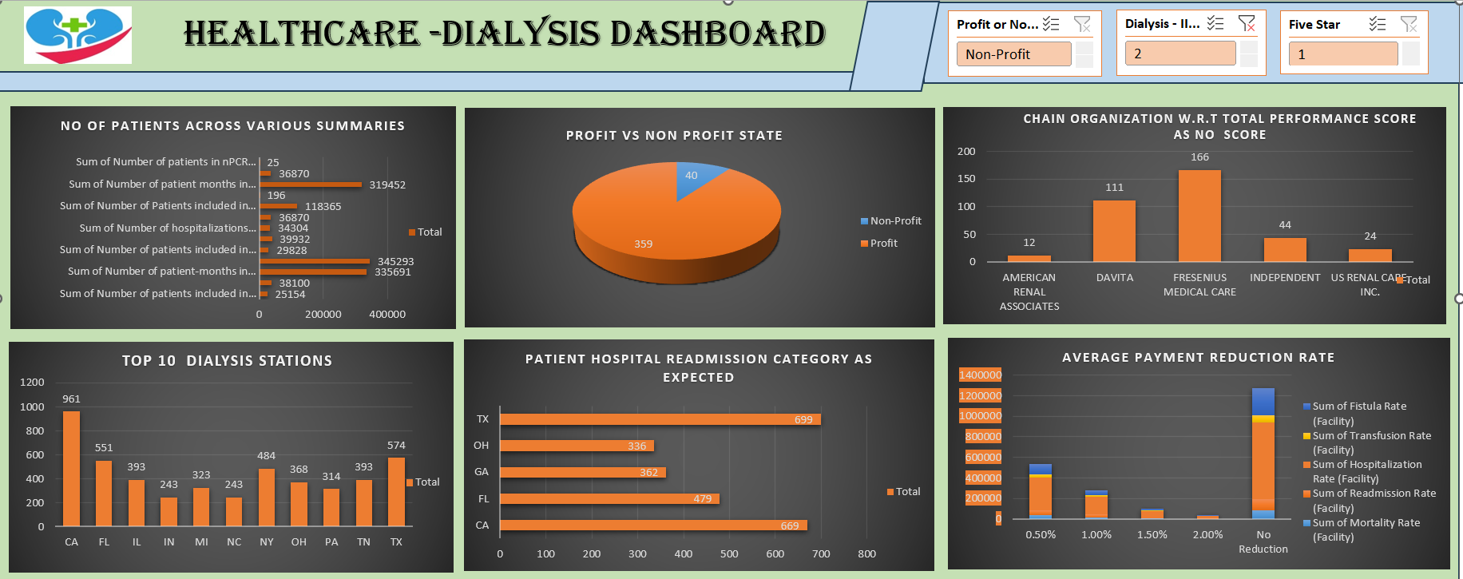

Slide 10
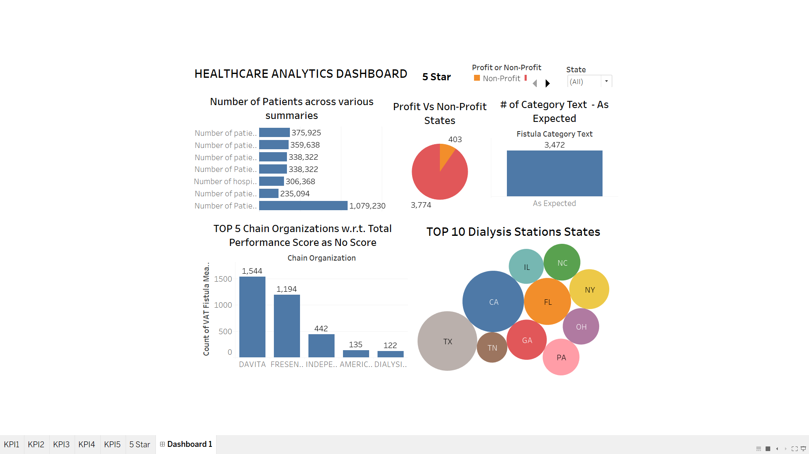

Slide 11
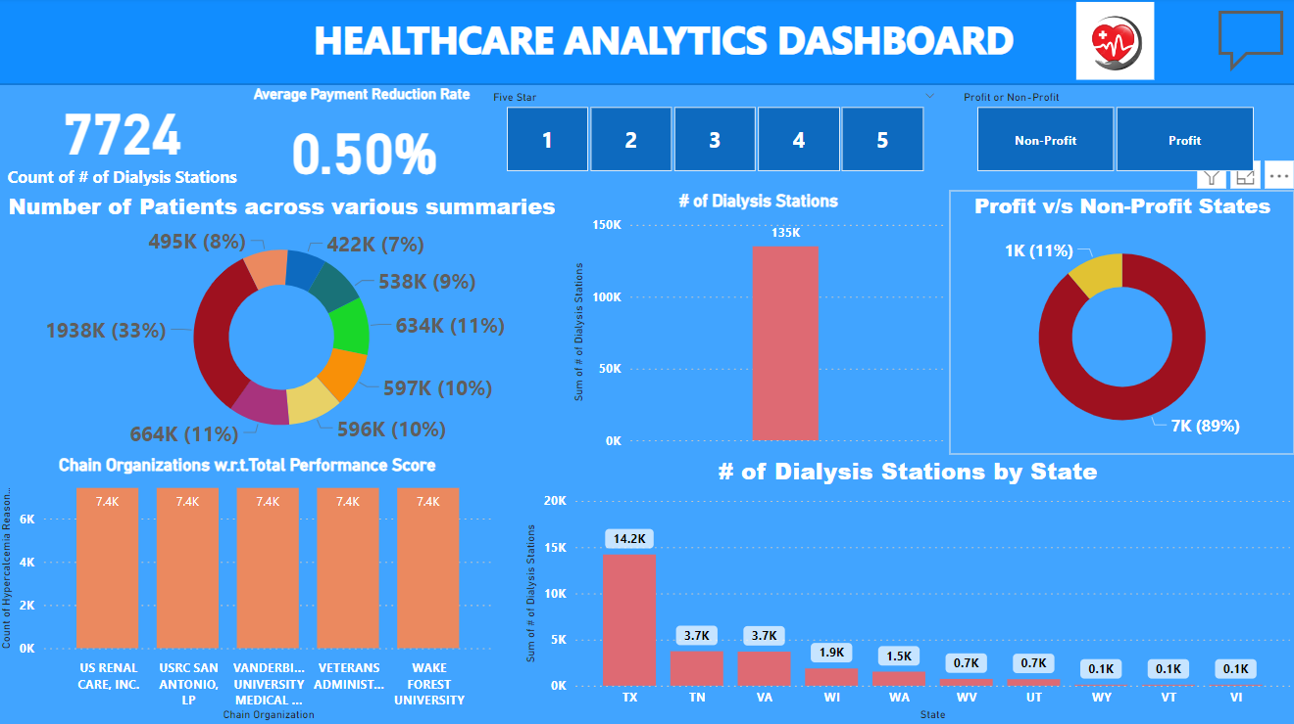

Slide 12
CONCLUSION
Survival summary has the highest patient count indicating positive outcomes , while NPCR summary has the lowest count.
Approximately 88.75% of facilities generate profit , while non-profit facilities need analysis.
The highest performance score was recorded in 1969, while the lowest was in 1971.
Intermountain Healthcare and Memorial Hermann have high performance scores ,while other need improvement.
The number of dialysis stations increased until 2018 and then started declining ,which is concerning.
The survival category has a good patient count, while hospitalization has the highest count.
Implementing cost containment strategies like operational efficiency improvements and optimized supply chain management can reduce costs.
Quality improvement initiatives , such as reducing readmissions and preventing medical errors , can lead to cost saving and better payment rates.

Slide 13
THANK YOU

